Slide 1
Data Science UW
Methods for Data Analysis
More on Regression and Graph Algorithms
Lecture 5
Nick McClure

Slide 2
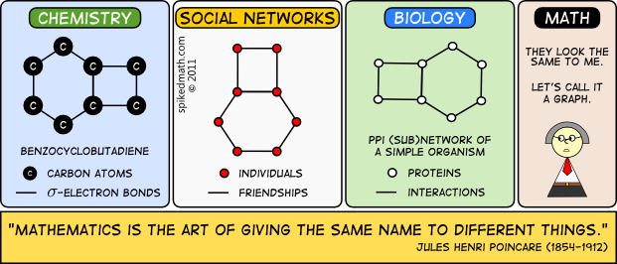

Slide 3
Topics
Review
Linear Regression
Introduction to Graph Theory
Common Graph Algorithms

Slide 4
Review
Normality Tests
KS Test
Shapiro-Wilk Test
QQ-plot: qqnorm()
Group Testing
ANOVA
Multiple Hypotheses Testing:
Bonferonni Correction (slightly strict)
Central Limit Theorem
Confidence Intervals
Linear Regression
MSE, R^2, least squares fitting

Slide 5
Linear Regression Assumptions
Linear relationship between dependent variable and independent variables.
Measurement error is random.
Residuals are homoscedastic. I.e, the errors are the same across all groups of independent variables.

Slide 6
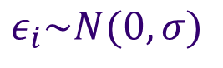
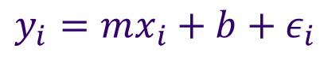
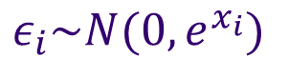
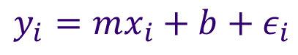
Homoscedasticity
Our assumed model:
Know that m,b, are all fixed parameters in that model.
Compare with:
$$y_{i}=mx_{i}+b+ε_{i}$$
$$ε_{i}\sim N(0,σ)$$
$$y_{i}=mx_{i}+b+ε_{i}$$
$$ε_{i}\sim {N(0,e}^{x_{i}})$$

Slide 7
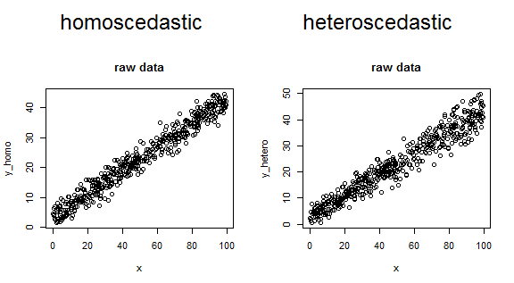
Homoscedasticity

Slide 8
Leverage and Cook’s Distance
Linear regression fits a line based on the means of the y and x values. It fits a line that goes through the means of both values.
The line pivots around that point relative to the pull of each point. Points that are further away from the mean pull harder on the slope.
Another way to quantify the ‘pull’ of each point, is to fit the line to the data without each point and see how the parameters move. This is called Cook’s Distance.

Slide 9
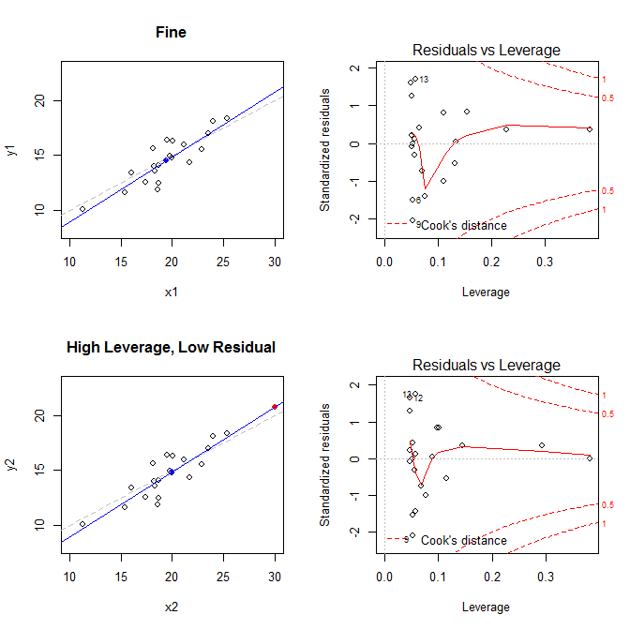

Slide 10
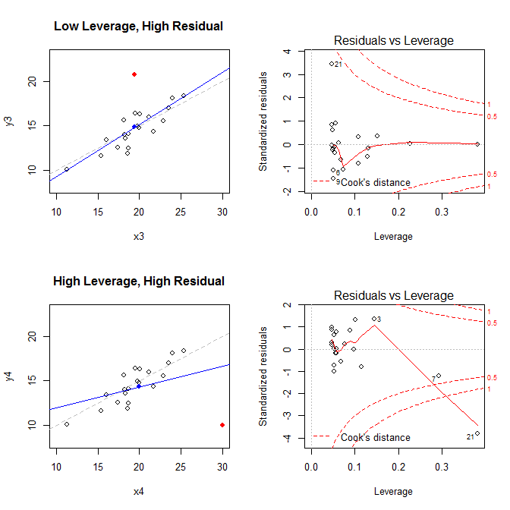

Slide 11
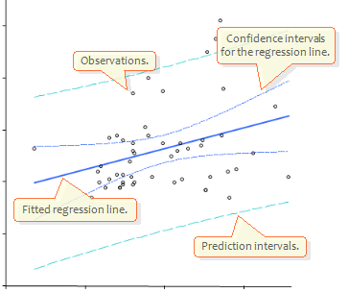
Prediction Vs. Confidence in Linear Regression
Confidence is the error we assign to the parameters. (m,b,…)
Prediction is the error in observing another point.
R demo

Slide 12
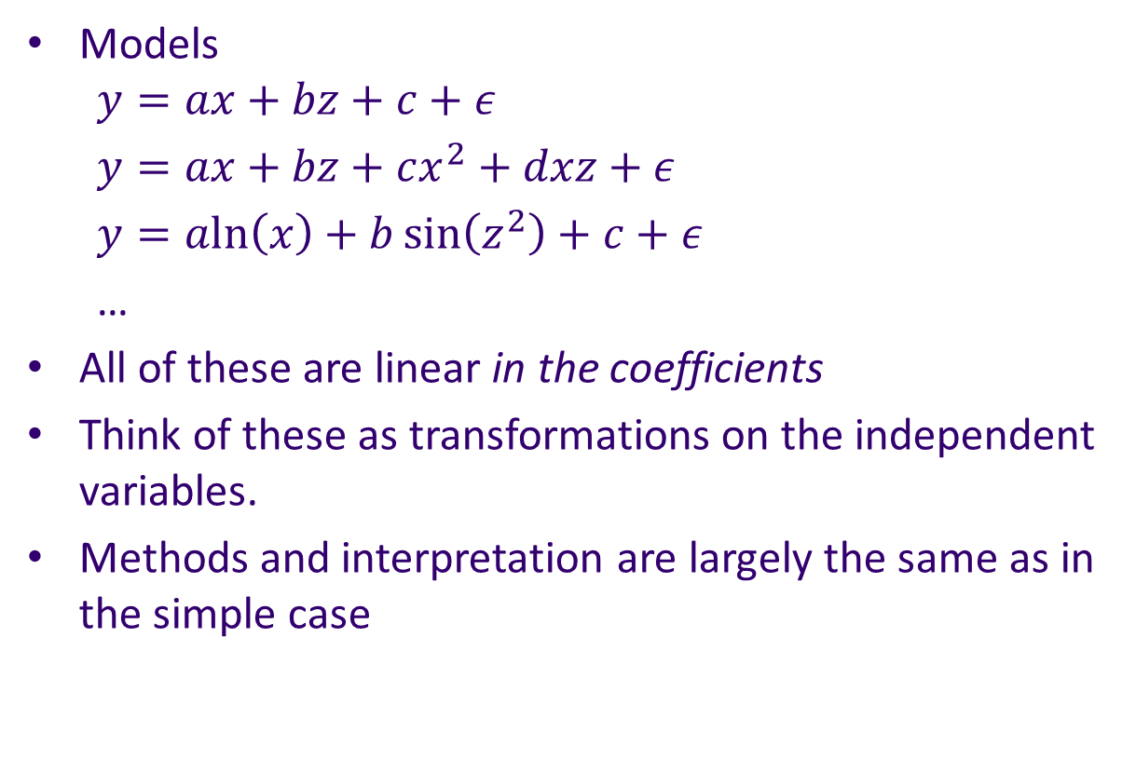
Linear Models
Models $y=ax+bz+c+ε$
$y=ax+bz+cx^{2}+dxz+ε$
$y=a\text{ln}\left(x\right)+b\sin\left(z^{2}\right)+c+ε$
…
All of these are linear in the coefficients
Think of these as transformations on the independent variables.
Methods and interpretation are largely the same as in the simple case

Slide 13
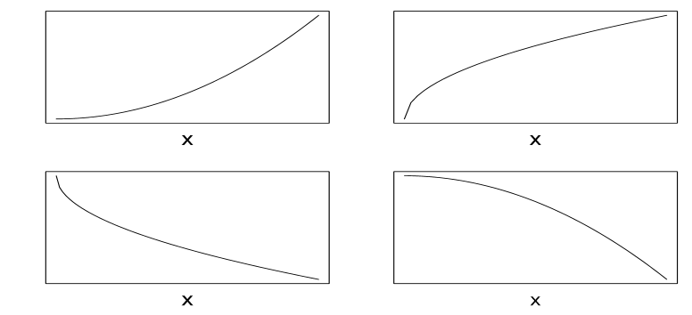
Non-Normal Data
Transform data to normality:
Examples:
R-Demo
Data(attenu) = peak acceleration data from the 1979 CA earthquake measured at 182 different sites.
Event: event #
Mag: magnitude
Station: Station factor
Dist: Distance from earthquake origin
Accel: Max peak acceleration
Exp(), power>1
Power>1
Log(), power<1
Power<1, sqrt()

Slide 14
Non-Normal Data
Transform data to normality:
Note you can only use monotonic functions for transformations for interpretability.
These are functions that preserve:
If a < b then f(a) < f(b).
Always either non-increasing or non-decreasing.

Slide 15
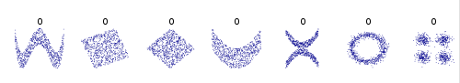
Non-Linear Relationships & Measurement Error
Other than transformations, we can’t do much here.
Solutions:
Fit a non-linear regression.
Use a non-regression machine learning model. (Touch on these at the end of the semester, and it is a large subject of the third class)
Cannot change measurement error, but you can control for it.
Example: Temperature measurements may have more variance at the high and low ends of an instruments limits. We can add a variable that takes into account how far from the limits the measurement is. More to come on this later.

Slide 16
Checking the Residuals
Always plot the residuals!
You should always check for trends in the residuals.
Residuals vs. fitted values:
We should never see a trend here. If there is a trend, our linear fitting failed.
Residuals vs. y:
Always positively correlated. The higher the correlation, the worse the fit. This is an effect of the influence of points on the end of the line. A point near the end has much more influence than a point in the middle. Because of this, higher values of y (near the end) tend to have higher residuals (and vice versa for lower values of y).
Testing the normality of the residuals is also important
Shapiro.test() in R.

Slide 17
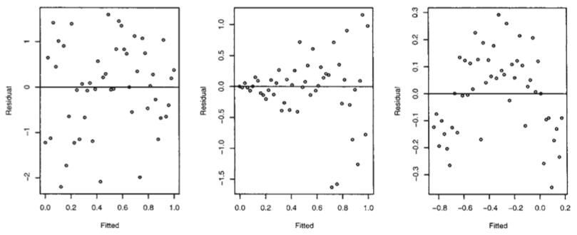
Trends in Residuals vs. Fitted
Types of outcomes:
Linear
Fan Shaped
Non Linear

Slide 18
Trends in Residuals vs. Fitted
Fan-shaped residuals (Heteroskedastic Residuals):
This does not affect our parameter estimates, but only our standard errors.
i.e. our population parameter confidence intervals are wider
In order to correct for this, we may try transforming our variables
Log transforms, sqrt transforms…
Non-linear residuals
Best solution is to use non-linear regression, we will touch on this later.
R demo
More in-depth statistics information:
https://cran.r-project.org/doc/contrib/Faraway-PRA.pdf

Slide 19
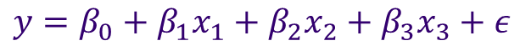
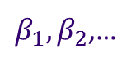
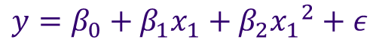
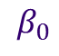
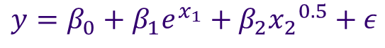
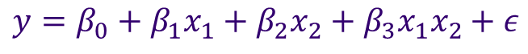
Multiple Linear Regression
Again, by linear, we mean linear in the parameters.
$$y=β_{0}+β_{1}x_{1}+β_{2}{x_{1}}^{2}+ε$$
Univariate Quadratic Model
$$y=β_{0}+β_{1}x_{1}+β_{2}x_{2}+β_{3}x_{3}+ε$$
First Order Model
$$y=β_{0}+β_{1}x_{1}+β_{2}x_{2}+β_{3}x_{1}x_{2}+ε$$
2nd-order Interaction Model
$$y=β_{0}+β_{1}e^{x_{1}}+β_{2}{x_{2}}^{0.5}+ε$$
First Order Model (with transformations)
$$β_{0}$$
is still the intercept (what y is equal to when all x’s = 0).
Are known as the partial slopes. Each one still represents the change in y per unit increase in x.
$β_{1},β_{2}$,…

Slide 20
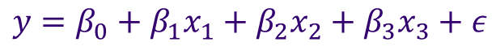
Multiple Linear Regression
Start with a first order model.
How do we deal with factor/categorical variables?
$$y=β_{0}+β_{1}x_{1}+β_{2}x_{2}+β_{3}x_{3}+ε$$
Gender
F
M
F
F
M
…
Gender
1
0
1
1
0
…
DayOfWeek
Monday
Tuesday
Wednesday
Thursday
Friday
Saturday
Sunday
…
DayOfWeek
1
2
3
4
5
6
7
…
Eye Color
Brown
Brown
Blue
Green
Green
Blue
Brown
…
Brown | Blue
1 | 0
1 | 0
0 | 1
0 | 0
0 | 0
0 | 1
1 | 0
… | …

Slide 21
Multiple Linear Regression
Throwing in all possible variables to help explain our response is sometimes not a good thing
Variables can be dependent on each other.
Variables might not be important to explain the response.
Note that the SSE is always larger for reduced models!
How do we choose which combinations of independent variables to use?
We might consider looking at the difference in SSE between models and the number of explanatory variables.

Slide 22
Multiple Linear Regression
Linear Model Likelihood
We assume errors are normally distributed. From the resulting set of errors, we can come up with a distribution. We then use each residual point and come up with a total error and calculate the probability of that model given our data. This is the likelihood.
To make the calculations easier, we usually take the logarithm of the model (remember we can do this because it is monotonic). This is called the ‘log-likelihood’. We will talk more about this when we get to Bayesian Statistics.

Slide 23

Multiple Linear Regression
Akaike Information Criterion (AIC)
Given a model with k-parameters, and a likelihood of L,
Note that the more parameters, the higher the AIC.
The higher the likelihood, the lower the AIC.
Better models have lower AIC values.
$$AIC=2k−2ln⁡(L)$$

Slide 24
Multiple Linear Regression
How to select the variables in the model?
Stepwise regression.
Forward Selection:
Start with no independent variables and add the variables one by one, selecting the variable that improves your criterion the most.
Backward Selection
Start with all independent variables and remove on at a time. Remove the one that improves the chosen criterion.
R-demo

Slide 25
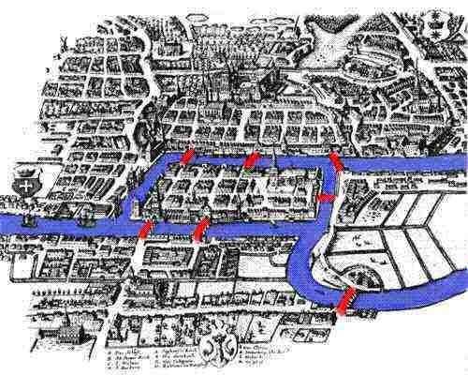
Introduction to Graph Theory
Leonhard Euler came to Konigsberg, Prussia in 1735 and solved a local problem: Can we go on a walk from home and cross each bridge exactly once and end up at home?

Slide 26
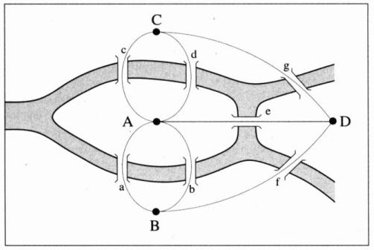
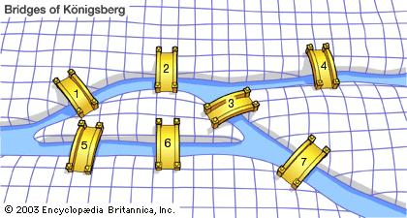
Graph Theory
Euler solved this by creating a graph of the problem.
A graph is made up of vertices and edges.
All edges have a vertex at both sides.
The degree of a vertex is the count of edges that end there.

Slide 27
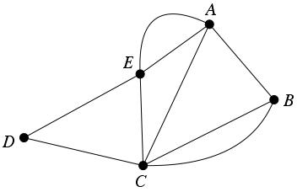
Graph Theory
Even Vertex
Let’s consider am arbitrary graph, G.
Properties of any graph:
The sum of all the degrees of a graph is even.
The sum of all the degrees of a graph is twice the # of edges.
There are always an even amount of odd vertices.
Odd Vertex

Slide 28
Graph Theory
Euler realized that the degrees in the graph are the most important part of solving this problem.
|A| = 5
|B| = 3
|C| = 3
|D| = 3
What’s wrong with having an odd vertex?

Slide 29
Why Graphs?
Graphs can theoretically represent any object.
In fact, one of the highest abstractions of mathematics is called category theory, which is represented by graphs.
For our purposes, that object can be a list, data entries, relationships, joins, etc…
Databases stored as graphs are a type of NOSQL (not only SQL).
Why the need? Databases are growing far too big (CAP theorem)
It is impossible for computers to provide all of:
Consistency (all users have equal access to all data)
Availability (every user gets a response)
Partition tolerance (the system operates the same under arbitrary partitioning)

Slide 30
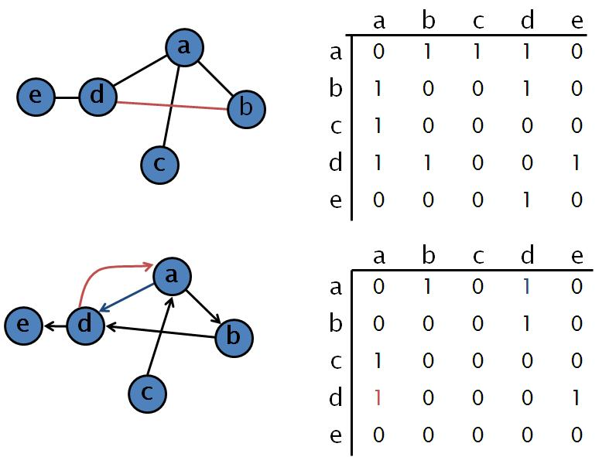
Representation of Graphs
Adjacency matrix

Slide 31

Representation of Graphs
Vertex-Edge Lists
Dictionaries (I prefer python for this)
E={‘a’:[‘b’,’c’,’d’],’b’:[‘a’],’c’:[‘a’],’d’:[‘a’,’b’,’e’],’e’:[‘d’]}
V=E.keys()
Vectors
V=((‘a’,’b’),(‘a’,’c’),(‘a’,’d’),(‘b’,’d’)…)
R:
igraph package
Lists:
E=list(‘a’=c(‘b’,’c’,’d’),…)
V=names(E)
iPython Demo

Slide 32

Python Aside

Slide 33
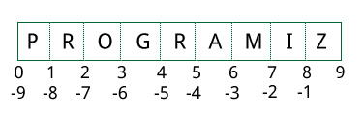
Python Aside
Python is arguably used as much as R in the data science world.
Focuses on readability and ease of usage.
Uses dynamic typing/whitespace.
‘Pythonic’: Only one obvious easy way to do things.
Not as statistically focused, but has very easy OOP, logging, and interfacing.
Ipython! (Jupyter) for data/algorithm exploration
Spyder for the R-studio user.
Dataframes = pandas
Numerical library = numpy
Statistics = Statsmodels, PyMC
Machine Learning = scikit-learn, Shogun
Plotting = matplotlib
Indexing is different!
Python Tutorial

Slide 34
Graph Algorithms
Recommended Connections:
Triangle completions (friends of a friend) (ipython example)

Slide 35
Graph Algorithms
Measuring Centrality: Finding important nodes/edges.
Of all shortest paths, which node/edge are traveled the most?
We traverse all combinations of pairs shortest paths and count how many times we crossed a vertex.
Probably not very important.
Probably very important.

Slide 36
Graph Algorithms
Graph Labeling/Coloring:
Minimum labels/colors needed for each vertex to not be connected to a similar label/color.
For a fully connected graph of n-vertices, you need n-colors.
For a planar graph (2D, no crossed edges), you need at most 4 colors (4 color theorem).
Algorithm:
Label a starting vertex of your choice with the lowest number (1)
For the remaining vertices:
Move to a vertex adjacent to your already labeled vertices.
Label that vertex the lowest number possible, not including any adjacent labels.
Graph Coloring is a ‘hard’ problem, i.e., the only way to guarantee the best result is by brute force.

Slide 37
Graph Algorithms
Use cases:
Scheduling: Given a set of jobs that need to be assigned to time slots. Given that some jobs cannot be scheduled together (i.e., the vertices are connected), coloring will provide the minimum time slots required.
Meetings for people. Nodes are meetings, edges represent the existence of shared people between meetings. Then a minimum coloring will represent the number of needed time slots for the meetings.

Slide 38
Graph Algorithms
Clustering Graphs: Finding subgraphs with similar properties
Algorithm:
Start with every point in it’s own group.
Find the two closest points, group them together.
Repeat this until…
Number of specified groups is reached, or
No distance is under a specified amount, or
Maximize (between group variation)/(within group variation).

Slide 39
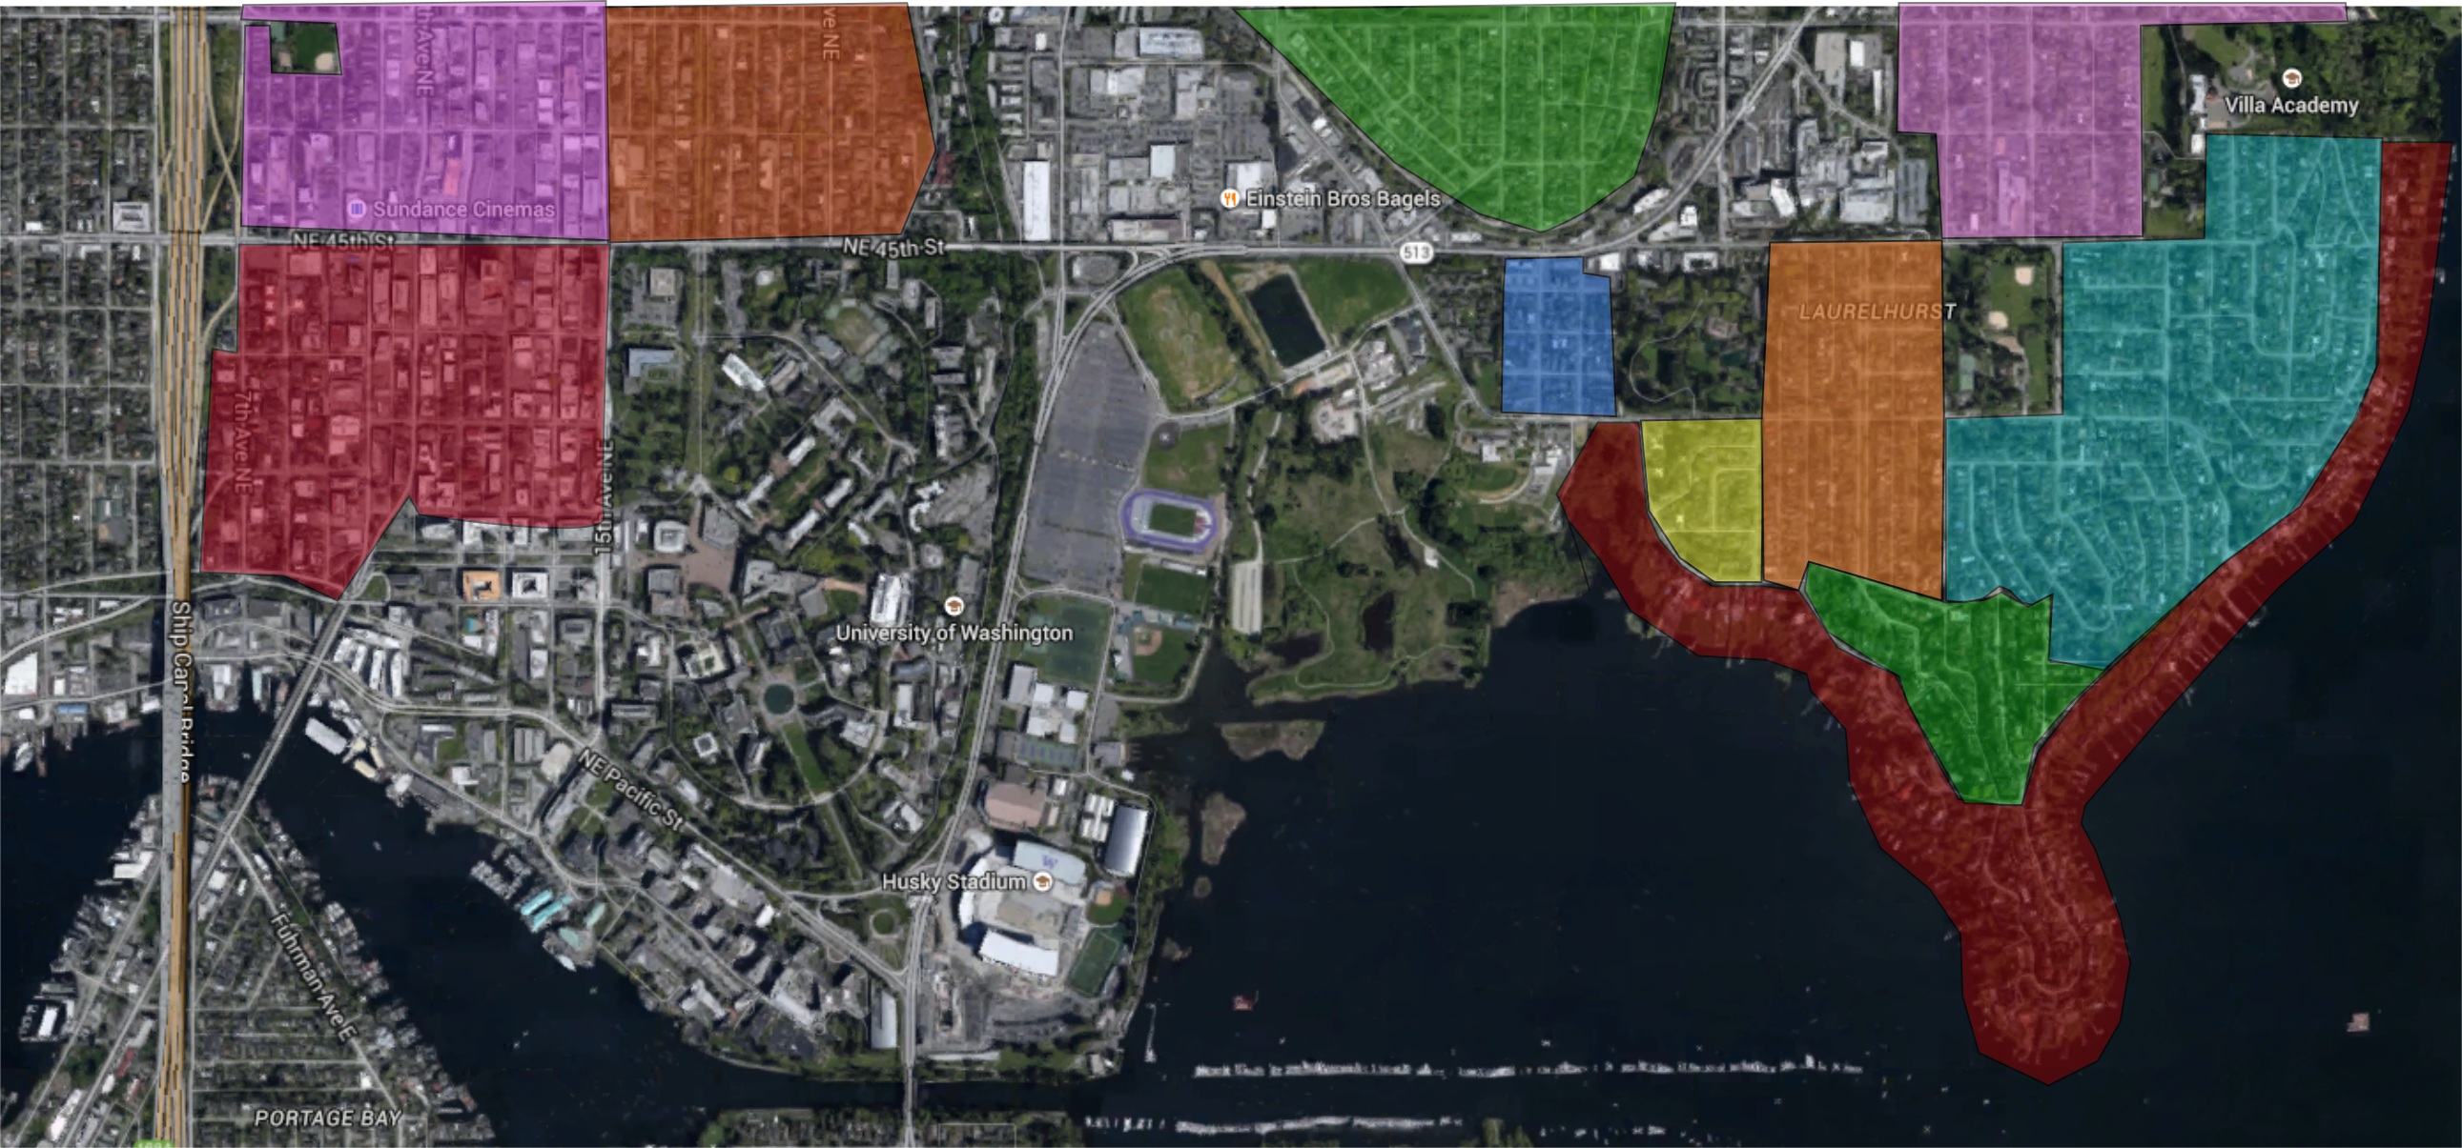
Graph Algorithms
Clustering Graphs: Finding subgraphs with similar properties
Zillow uses graph structures to find similar houses for imputation purposes. We can find ‘similar’ neighborhoods using this method.

Slide 40
Graph Visualization
Gephi: Open-source free graph visualization tool.
http://Gephi.github.io
Still in beta, has a few bugs, but a great tool overall.
Gephi Example.

Slide 41
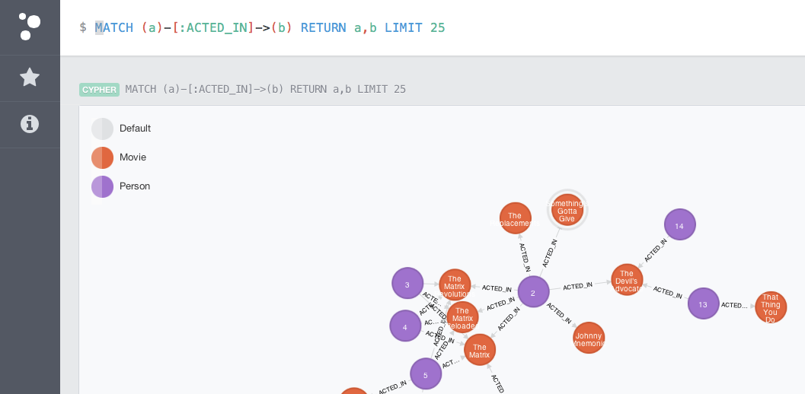
A Note on Graph Databases
Graph databases store data in graph-like structures.
Queries are querying graph structures
Neo4j: Leading developer of Graph Databases.
Free online tutorial.
http://neo4j.com/graphacademy/online-training/
Who uses neo4j? www.stackshare.io

Slide 42
A Note on Graph Databases
More information available:
http://infolab.stanford.edu/~ullman/focs/ch09.pdf

Slide 43
Assignment
Complete Homework 5:
Load Facebook edges file.
Write R code that computes the mean degree and shows a plot of the histogram of degrees. Verify this with Gephi.
Perform a K-S test for the following:
Test if the distribution of degrees is Poisson. (reuse K-S code)
Test if the distribution of degrees is a Power Law. (igraph)
You should submit:
A production level R-script.
A text document summarizing your findings.
Read Statistical Thinking for Programmers pages 93-97.

